Slide 1
Advocating for Operability to Improve Test Strategy

Slide 2
What is a Run Book?
A Run Book is a set of headings and questions that cover operational concerns in most software systems.

Slide 3
Why is it important?
System & business context
Who owns/knows what
Management of incidents and outages
Locations & meaning of logs, monitoring and health checks
Restoring service & failover strategies
Deployment/rollback
Any many more

Slide 4
Your run book experience…
Heard of one?
For your application?
Take part in creating it?
Ever done an incident post mortem
Are on call support?

Slide 5
What is a (good) test strategy?
Balanced but varied
Inclusive of team testing activities
Evolves with context
Starts a conversation
Business risk
Any more?

Slide 6
Run books and test strategies
About discovery & exploration
Designed to provoke discussion
Best as a whole team effort
Shows gaps in system and technology knowledge

Slide 7
Hypothesis: Completing a run book for your system will improve your testing…

Slide 8
Stage 1: Draw the Testing Quadrants
Thanks to various including Lisa Crispin, Janet Gregory, Brian Marick

Slide 9
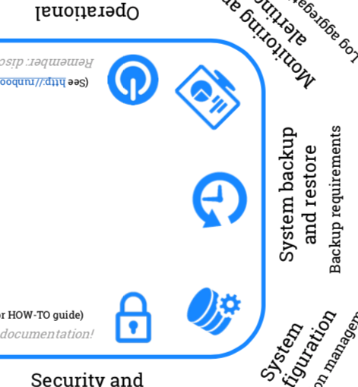
Stage 2: Run Book Template
Handout of dialogue sheet
Explanatory notes: http://tiny.cc/77145y
Think about how you this information helps your testing
Thanks to Matthew Skelton for this awesome template and research

Slide 10
Stage 3: Bring them together
Add elements of the run book to your quadrants based on:
Best suited quadrant for that info
Type of testing that would benefit most
Business Overview
Patching

Slide 11
Reflect…

Slide 12
Next!

